Slide 1
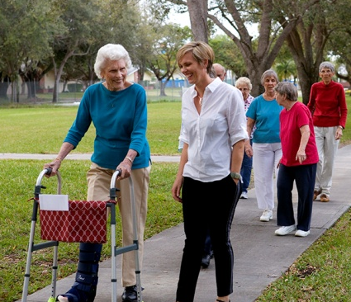
United Methodist Village
presents
SmartMoves Healthy Learning Lectures
Osteoporosis
presented by Travis Harper
Did you know that osteoporosis can affect men and women? It is estimated that 50% of women over 50 years old will break a bone due to osteoporosis. Unfortunately, this condition does not have any early symptoms but diagnosis is fairly easy. There are supplements and medications to help with osteoporosis, and weight bearing exercise is suggested for most people, but do you know what you should be taking or what exercises you should do or avoid? If you’d like to learn more about Osteoporosis, come to the lecture on November 21st in the chapel!
Date: Tuesday, November 21st Time: 10am
Location: Chapel
For more information, contact Travis Harper, Wellness Coordinator at 314-223-9575

